Slide 1
Sex specific evolution of meiotic recombination rates
Payseur lab meeting 12.2.20
April Peterson
Notes:
Goals for getting out of lab meeting:
Feed back for test choices
Push to write and distribute a draft of my results outline
Practice summarizing results

Slide 2
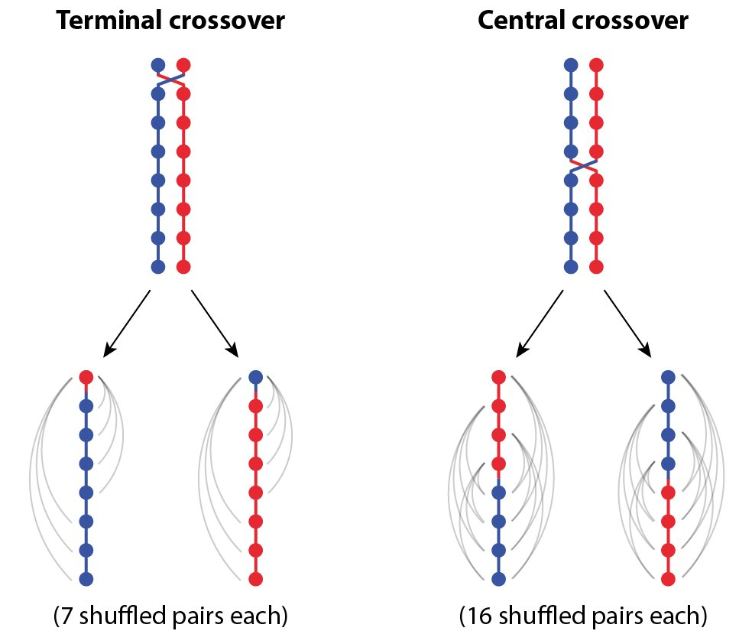
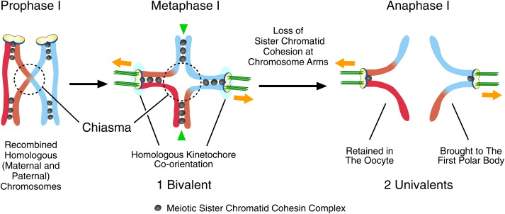
Evolution of Recombination Rates
Indirect selection
Direct selection
2n -> 4n -> 2n -> 1n
Veller, Kleckner, and Nowak Proceedings of the National Academy of Sciences 116.5 (2019): 1659-1668.
Kudo, Nobuaki R., et al. "Resolution of chiasmata in oocytes requires separase-mediated proteolysis." Cell 126.1 (2006): 135-146.
Direct selection
Notes:
Types of evolution of recombination
-- indirect effects – genetic diversity (veller figure
Genetic variation – novel combinations of alleles, escaping from Muller’s ratchet
-- direct effect -- segregation at MI, cohesion + CO = chiasmata facilitates tension force needed for proper segregation.
Known sex differences at these levels for recombination
1) Males/sperm produce recombinate chromsomes with more telomeric places COs
2) Egg’s have higher segregation errors (esp mammals)

Slide 3
Genome wide RR in house mouse
Notes:
How I’m studying sex differences in rec evolution
-example of spreads – cytological approach
- House mouse is great model for evolution – natural populations all over the world – and deep history as a resource for genetic /biological research
Mammals are easy to dissect across life stages – which is needed to get embroyonic ovaries at the right stages of meiosis
MLH1 are COs, mammalian cells are big and protocols for making cell spreads work well.

Slide 4
MLH1 count per cell
Ran Mixed model
Lmer( mean_co ~ subsp * sex + (1|strain) )
ALL 4 Effects are significant
glm( mean_co ~ subsp * sex * strain) )
glm( mean_co ~ sex * strain) )
G strain, PWD*male, and MSM*male are most sig effects
Lmer( mean_var ~ subsp * sex + (1|strain) )
glm(mean_var ~ subsp * sex * strain) )
glm(mean_var ~ sex * strain) )
Sex is the most significant effect, females have greater variance
Molossinus
Musc
Dom
Some strain effects increase both male and female gwRR
Notes:
Review all the logic and results for the models of the whole data set.MLH1

Slide 5
Female MLH1 Means
glm( mean_co ~ subsp * sex * strain) )
glm( mean_co ~ sex * strain )
G and MSM are most significant strain effects;
G is 10% higher
MSM is 8% high
(LEW is 3% higher)
Molossinus
Musc
Dom
Notes:
Put the sex specific results here
Ran glms
G, MSM have most significant p.vals for strain effect
Lew very slight straing effect
Mean G is 10% higher than the average female mean
MSM is 8% high
(LEW is 3% higher)
Variance models → females have significantly larger between cell MLH1 count variance
G mean 28
MSM 27
MOLF 27
But I think with the difference number of mice, this is how the lm shakes out

Slide 6
Male MLH1 Means
glm( mean_co ~ subsp * sex * strain )
glm( mean_co ~ sex * strain )
PWD, MSM and SKIVE significant strain effects
20%, 30%, and 11% higher than other means
PWD, MSM and SKIVE labeled as ‘High Rec’
Rapid sex-specific evolution in PWD, MSM, and SKIVE.
Molossinus
Musc
Dom
Notes:
Male mlh1, ran mixed models and glms – the main finding was that there were 3 significant strain effects
Glm’s
PWD, MSM and SKIVE have significant strain effects, they are know high rec strains -- the rest of the strains have lower averages
So this is raivdence of rapid – sex specif

Slide 7
Double Strand Break Counts
Notes:
DMC1 are markers of DSB’s
We measured this to investigate the time line

Slide 8
Notes:
Chromsome class propotion compisons – done to dissect the (cell wide) gwRR average
-high strains (G and MSM) and (PWD, MSM, SKIVE) – have significantly more 2CO bivalents
-chisquare tests for difference in proportions, many significant proportion differences. Propotions are most similar for the rec.groups in males.
-(gwRR evolution is facilitated through chrm levels)
(what about the female findings: G, MSM, )
**MSM 60% > PWD 50% > SKIVE 30% > 20 - 10% remaining (low) strains**
Male pattern
**MSM 60% > PWD 50% > SKIVE 30% > 20 - 10% remaining (low) strains**
Female pattern
High female strains, G and LEW,
High Rec females have more 2CO chrms, ~33% vs (23% - 27%)
Male pattern
**MSM 60% > PWD 50% > SKIVE 30% > 20 - 10% remaining (low) strains**

Slide 9
Single Bivalent Dataset
~ 10,400 Automated Single Bivalent Measures
Not full cell, but samples equally representative of general patterns
3 types of metrics
1. Length of individual bivalents (SC signal)
2. Position of single CO on a bivalent
3. Interference strength, InterFocal Distance (IFD)
Notes:
Example to illustrate the Bivalent Data
Almost all the mice used in the MLH1 data set – have Bivalent observations
Automated measures that have been curated by a human
Not all images isolate or use every bivalent across cells (average 17) – but the isolation isn’t biased and since there so many observations – we assume the bunches of bivalents from each group are similarly representative of general patterns

Slide 10
Single Bivalent Sex Specific Patterns
Q1) What are general differences between bivalent patterns in oocyte and spermatocytes?
Predictions
1. SC length will be longer in females
2. 1CO normalized positions will be sexually dimorphic
3. No sex difference in physical distance (SC units, (IFDraw)) between foci on the same bivalent.*
de Boer, E., Stam, P., Dietrich, A. J., Pastink, A., & Heyting, C. (2006). Two levels of interference in mouse meiotic recombination. Proceedings of the National Academy of Sciences, 103(25), 9607-9612.
Notes:
(motivation)
Given the findings with the gwRR -> chrm proportions -> look at single bivalent pattern
(chromatin compaction, interference and known sex specific rec landscape features)
(Brief summary for dataset)
(Focus is on 2 main questions)
Animate so that they appear sequentially, then ii) fades
Example questions
Walk through these predictions:
The first 2 are well supported by the literature, while the 3rd there is only 1 paper I could find with cytological data for interfocal distance for both sexes.

Slide 11
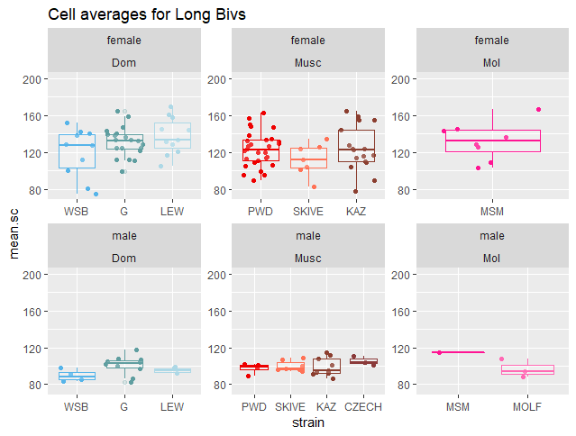
Q1 SC Lengths
Caveats due to XX, but several reasons that support female SC’s being longer:
Within a cell, ALL bivalents are longer
Long biv measures
Permutations of 19 female, 20 male random bivalents are not significant.
Notes:
Explain caveat which come from comparison SC lengths across sexes
The XX is like an extra autosome, since it’s a larger bivalent –it will bias the a mean. (in the case of sc lengths being the same across sexes – and only difference is the sample size for calculating the mean, an extra sample above the mean will make the means different (if XX was middle sized there would be no effect)
Why
Use cell average Long bivs in models

Slide 12
Q1 IFD and interference
High rec males: Sharp threshold of normalized IFDs ~ 30%
Females: enrichment of shorter normalized IFDs
Sim means, for raw IFD
Male mean greater
Threshold for the males, not in the females

Slide 13
Q1 Results Summary
SC Lengths
Average bivalent SC length is significantly longer in females
Interference, IFD measures
Males have longer nrmIFD, indicating stronger interference
Some females have longer rawIFD, but PWD*male and SKIVE*male had the most significant pvalues (longer raw.IFDs) indicating these strains have a reduced degree of sexual dimorphism
Nrm.F1.pos
Expected sexual dimorphism, 1COs in females have more central position, and telomeric in male
Notes:
SC length notes
-longer average bivalent lengths,
All bivalents within a cell are longer
Permutation sampling of 19 female random bivalents (compared to male permutations of random sample of 20) – these permutations don’t have similar means. Adding or taking away an extra ‘autosome’ doesn’t change the mean bivalent calculations – enough to overlap with the other sex
Interference
-low number of significant effects for both raw and normalized IFD
-Generally females have longer rawIFD, but PWD*male and SKIVE*male had the most significant pvalues (longer raw.IFDs) indicating these strains have a reduced degree of sexual dimorphism
-Male effect was most significant effect for nrm.IFD
- MALES have longer nrm IFD – which fits with linkage map measures, interference being stronger in males (weaker in females) – I don’t understand how linkage map interference patterns translate to nrm.IFD since there aren’t genomic locations
The overall narrative I’m trying to weave – more variance in females
-Between cells (MLH1 counts)
- Uniform spacing (the 1CO position is not regulated) (F1 variance is probably larger (F1nrm))
- IFD spacing / interference strength
- Lack of distinction between 1CO and 2CO lengths
(longer SC lengths (variance in SC length / I’m not sure this makes sense))
deBoer Summary:
MSH4, in WT and Sycp1 -/-. (found 2 classes of COs / two types of interference). Used FISH for chrms 1,2,18,19; calculated gamma distribution from chrm specific intervals
Interference much stronger for MLH1 in pachytene
Sex differences --- ?
(the density of MLH1 on SC-AE is more dense in males than females)
Male – short chrms had strong medial placement of MLH1
(Can I access these data?)

Slide 14
Q2. Single Bivalent Males High and Low Rec strains
Q2) What are the differences between high musc and low musc strains?
Bivalent metric predictions
1. Interference will be weaker in High.Rec strains (IFD will be shorter)
2. SC length will be longer in High.Rec strains
3. 1CO normalized positions will not be different
Expected patterns based on MLH1 results, for SC length and IFD (opposite for interference).
A. Dom, (WSB = LEW = G)
B. Musc, (PWD > SKIVE > KAZ, CZECHII )
C. Mol, (MSM > Mol)

Slide 15
Q2. Caveats and Complications
Mean Bivalent SC Length
-Average bivalent lengths are confounded by the different proportions of chromosome classes in the High.Rec and Low.Rec strains.
Solutions
1. Testing whole cell measure of SC
2. testing long.biv and short.biv means. Top 5 and bottom 5 bivalents from single cells.
Notes:
Classes of chromosomes (1CO, 2CO) already have expected SC length differences (based on their physical MB size.
High.Rec strains have more 2CO bivalents – their 1CO pool will have shorter bivalents, and 2CO will be
Low.Rec strains have more 1CO bivalents – this pool will include a range of short and long bivalents
If I compare the average sizes of bivalents divided by classes ---

Slide 16
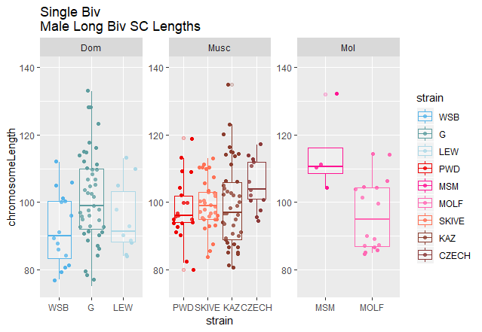
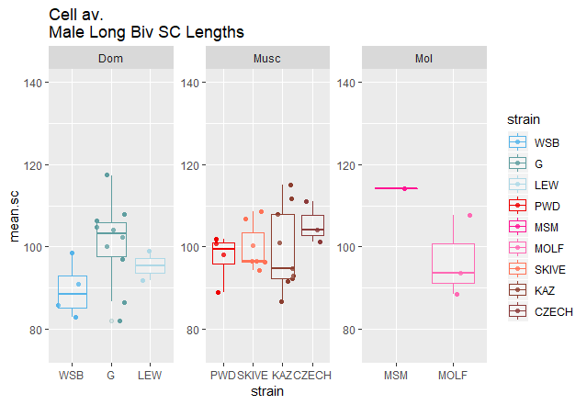
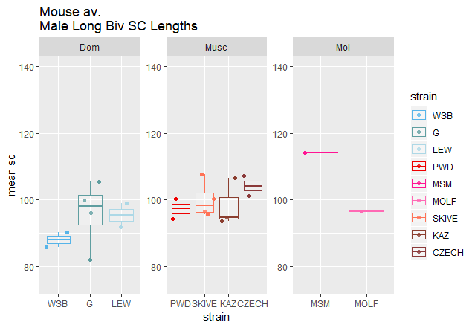
Q2. Long Biv SC Lengths
All bivalents with SC longer than 4th quartile for SC length distribution of 1 cell -> Long.biv data set
Limited by automated measures with >16 bivalent measures per cell
~5 cells per group
Single Bivalents
Cell averaged
Mouse averaged
Notes:
At first I thought this comparison
This comparison should make sense because the bivalents are being filtered by sc length in comparison to the other bivlents within the same cell.

Slide 17
Q2. Long Biv SC Lengths
Notes:
SKIP THIS JUST FOR display
At first I thought this comparison
This comparison should make sense because the bivalents are being filtered by sc length in comparison to the other bivlents within the same cell.

Slide 18
Q2. IFD Interference
Notes:
Models support high rec strains – having larger interference

Slide 19
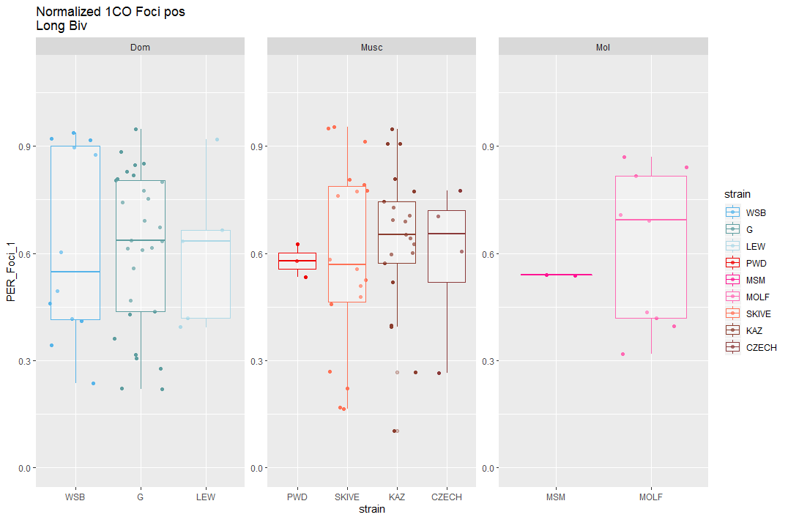
Q2. Normalized 1CO LongBiv’s
Same chromosome size issues for Foci Position,
Normalized 1CO Foci Position
General pattern of
High.rec strains having more central F1 pos is kinda met
Normalized F1 Position
Each point is a bivalent with 1CO
(multiple mice rep)
Notes:
Pattern almost reversed
WSB has lowest mean
To control for chromosome size effect, use LongBiv observations.
- Controls for SC difference
- (more) control for chromosome identity

Slide 20
Q2. Nrm.F1.pos Long.Biv
Normalized 1CO Foci Position
General pattern of
High.rec strains having more central F1 pos is kinda met
Normalized F1 Position
Each point is a MOUSE average of all the Long.Biv measures
Notes:
I guess the mouse averages do indicate that higher rec strains have more centromeric F1 pos.
Each point is a mouse

Slide 21
Q2 Results Summary
Rapid male specific evolution of gwRR is associated with:
More DSBs
Stronger CO Interference
~High.rec strains have longer SC
Some complications for comparing SC Lengths – (between cell variation in SC lengths and incomplete cell observations)
More variation in traits for Dom

Slide 22
Overall summary
Female traits have more variance
Number of MLH1 foci per cell, range of classes, Var( MLH1 )
Longer SC and sparser CO placement
Weaker interference -> more uniform Rec.Landscape
Males traits might be more tightly regulated
Shorter SC, smaller range in SC across bivalents
Strong interference and position bias make more consistent Rec.Landscapes across cells
--- distinct evolutionary forces – acting on rec landscape ( → gwRR ) for oocytes and spermatocytes
Notes:
Female traits have more variance
-longer SC but less dense
-weaker interference -> more uniform rec landscape
-number of MLH1 foci per cell – much higher variance (some cells with below min some cells with many
Males (traits might be more tightly regulated)
- strong interference --
- Telomeric position of 1CO
- ()str
Rapid evolution for the total number of COs per cell – but the rec.landscapes across all the bivalents might be more similar compared to females

Slide 25
Glm M2, and main points
G strain, G*male effects, driven by large difference between male and female means.
PWD*male and MSM*male driven by male specific elevate rates
No SKIVE strain effect, no sex difference between male and female strains. Analysis of only male data, SKIVE strain is significant.
glm(mean_co ~ sex * strain, data=DF.HetC.MixedModel.HQ)
 | Estimate | Pr(>|t|)
(Intercept) | 24.71164 | 1.28E-87
Sex male | -0.15644 | 0.822008
strainG | 3.297524 | 1.95E-06
strainLEW | 1.696468 | 0.019408
strainPWD | 1.158224 | 0.065356
strainMSM | 2.977214 | 6.95E-06
strainMOLF | 2.907357 | 0.096333
strainSKIVE | 1.226357 | 0.480969
strainKAZ | 0.85569 | 0.234412
sexmale:strainG | -3.17191 | 0.001651
sexmale:strainLEW | -1.19095 | 0.278086
sexmale:strainPWD | 3.592951 | 0.000535
sexmale:strainMSM | 3.723836 | 0.001962
sexmale:strainMOLF | -3.22256 | 0.09905
sexmale:strainSKIVE | 1.454443 | 0.460095
sexmale:strainKAZ | -0.80789 | 0.43176

Slide 26
Threshold not as strict --- in ‘low’ rec straions

Slide 27
DMC1 Results

Slide 28
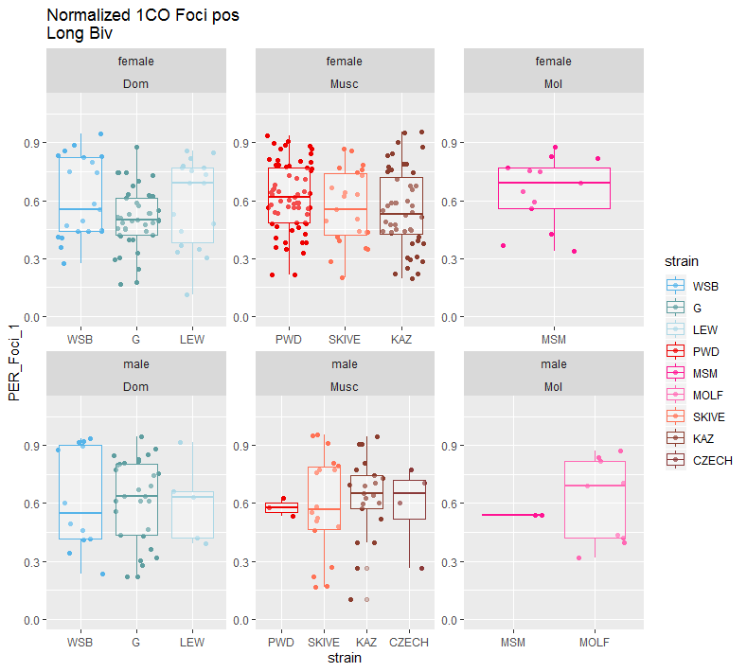
Normalized 1CO Foci Position Long Biv
To control for chromosome size effect, use LongBiv observations.
- Controls for SC difference
(more) control for chromosome identity
Make a table

Slide 29
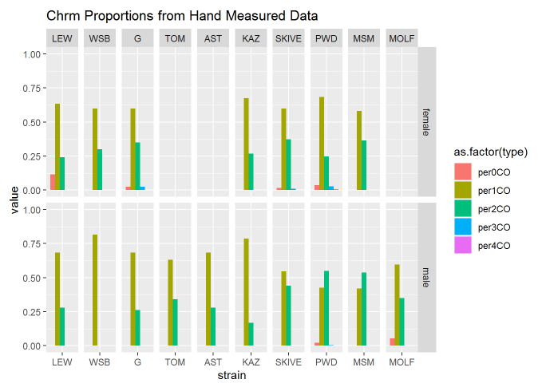
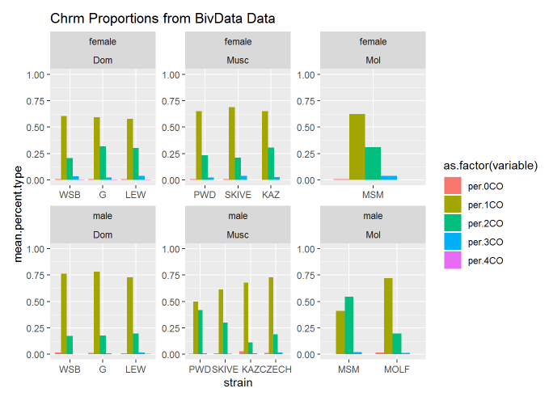
Chromosome proportions
The mice with distinct gwRR

Slide 30
Q2 Caveats / Complications part II
Normalized F1 Position
-there’s more chromosome size effects – complicating things.
(small (Mb) chrms usually have more uniform CO position landscape)
Solution
-measures in long and short biv groups

Slide 31
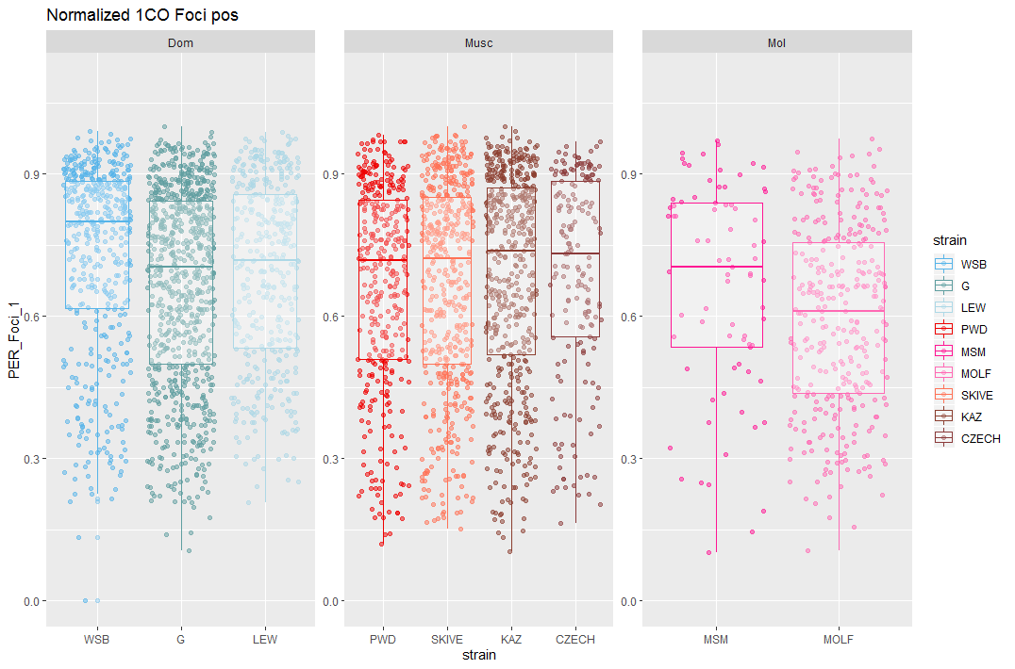
Normalized 1CO all Bivs
Normalized F1 Position
Notes:
Don’t trust --- these measures --

Slide 32
Summarize sex specific bivalent patterns
(figure ideas?)
Main data / tables
Conserved sex specific metrics for single bivalents during meiosis
- SC compaction
- uniform CO placement
Surprise, interference is not conserved… (raw value long in females, normalized versions females have sub class of close together
General pattern – for revisiting in discussion
Female meiotic pathway is less controlled/regulated
Notes:
The overall narrative I’m trying to weave – more variance in females
-Between cells (MLH1 counts)
- Uniform spacing (the 1CO position is not regulated) (F1 variance is probably larger (F1nrm))
- IFD spacing / interference strength
- Lack of distinction between 1CO and 2CO lengths
(longer SC lengths (variance in SC length / I’m not sure this makes sense))

Slide 33
SC Length
1. Dom are different
2. Musc strains? (PWD and SKIVE most different)
 |  | cells | mean
WS |  | 21 | 177.7619 | L
G |  | 19 | 158.1579 | L
*PWD | High | 18 | 180.2222 | L
*MSM | High | 17 | 231 | L
KAZ |  | 1 | 159 | L
WSB |  | 20 | 144.25 | Z
G |  | 9 | 131.7778 | Z
*PWD | High | 18 | 140.7778 | Z
*MSM | High | 17 | 164.4118 | Z
KAZ |  | 11 | 167.3636 | Z
Inter-
Focal
Distance

Slide 35
-lme4 (use RLTR exact() for testing random effects --- what are the random effects in these models?
-ANOVA? (one way anova – 1 factor in this group is different from the others
fit <- aov(y ~ A, data=mydataframe)
ANOVA test hypotheses:
Null hypothesis: the means of the different groups are the same
Alternative hypothesis: At least one sample mean is not equal to the others.
http://www.sthda.com/english/wiki/one-way-anova-test-in-r
Non-sig anova
Sig anova
Sig anova
Pairwise t.test results for the 3 subsp
Notes:
Discussion
Table X, Current models and their predictions for the evolution of heterochiasmy
Table X, results from proposed predictions
(Figure X, cartoon of difference in bivalent on spindle for 1CO and 2COs)
Review main patterns
Male specific polymorphism for gwRR in musculus and molossisnus, may not be a species wide optimum for gwRR
More variance in females for meiotic features, resulting in greater variation in gwRR
Rapid male specific evolution upstream of CO repair stage
SACE predictions and bivalent selection models are not mutually exclusive,
Importance of broad scale patterns for recombination
(centromere effects for mis-segregation rates) - (high rate of robertsonian translocation in Dom, and absent in Musc – maybe something about centromeres (encourages transloactions + suppresses 2CO (rec near centromere) in DOM
(that has changed in Musc, REC near centromere suppresses rates of robertsonian translocation)
Discussion
Table X, Current models and their predictions for the evolution of heterochiasmy
Table X, results from proposed predictions
(Figure X, cartoon of difference in bivalent on spindle for 1CO and 2COs)
Review main patterns
Male specific polymorphism for gwRR in musculus and molossisnus, may not be a species wide optimum for gwRR
More variance in females for meiotic features, resulting in greater variation in gwRR
SACE predictions and bivalent selection models are not mutually exclusive,
Importance of broad scale patterns for recombination

